Slide 1
Deflection of Beams
Chapter 9

Slide 2
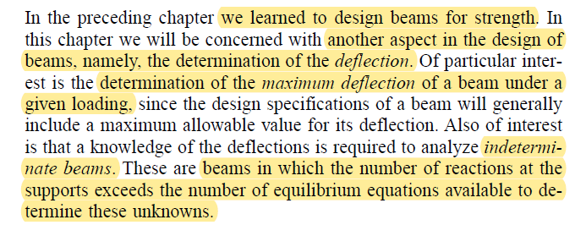
INTRODUCTION

Slide 3
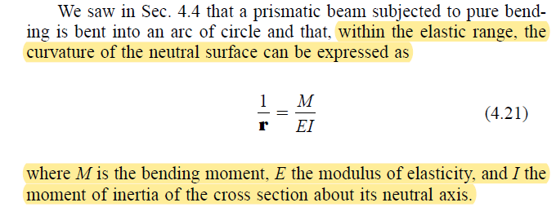

Slide 4
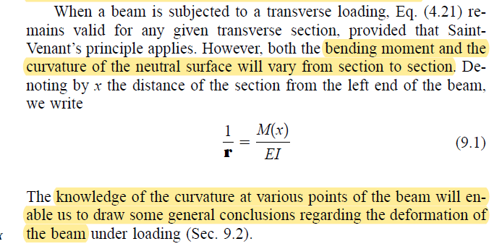

Slide 5
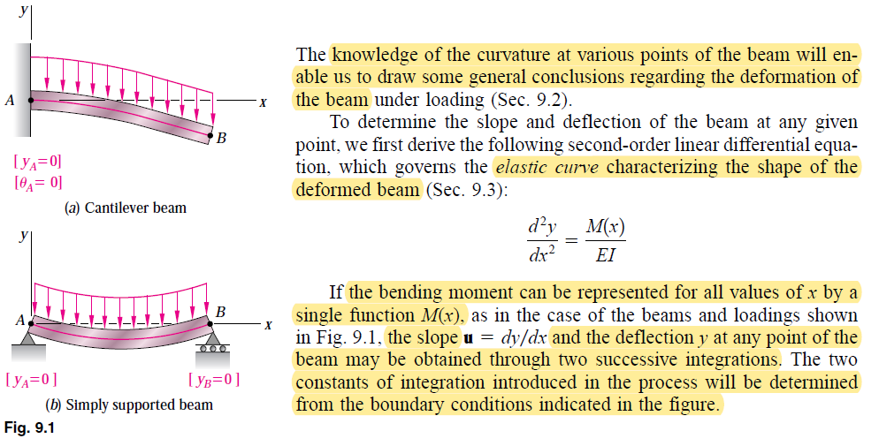

Slide 6
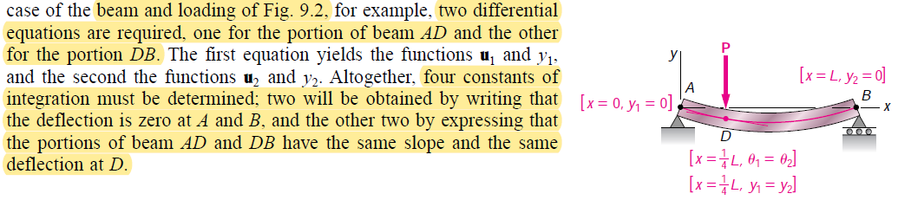

Slide 7
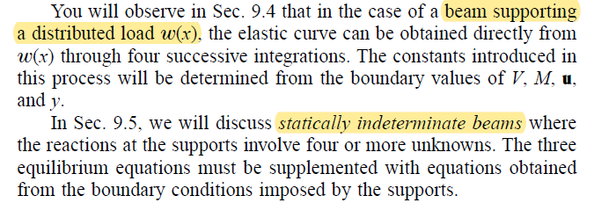

Slide 8
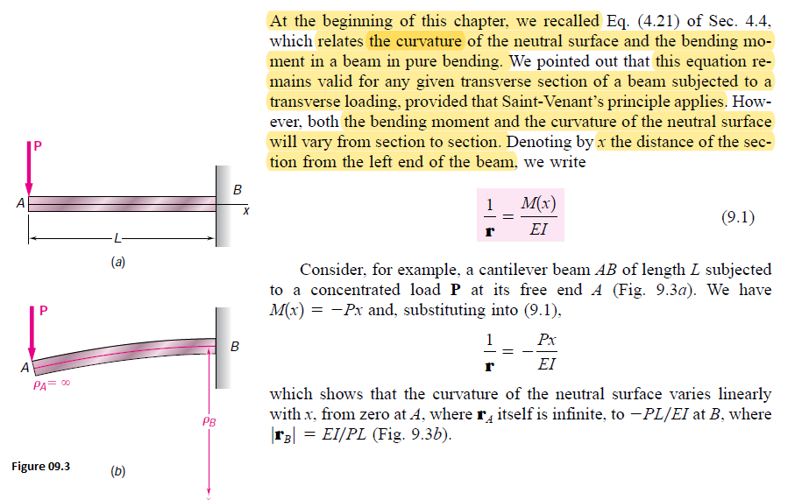
Deformation of Beam under Transverse Loading

Slide 9
Saint-Venant's Principle
The principle, stated roughly, asserts that if self-equilibrated loads are applied on one end only of a long cylinder, then the strain produced in the body by such forces are much larger near the loaded end than at points far from the loaded end.

Slide 10
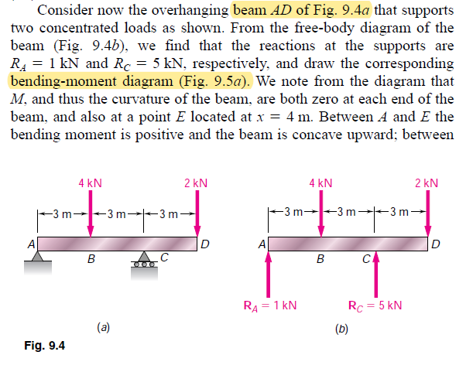

Slide 11
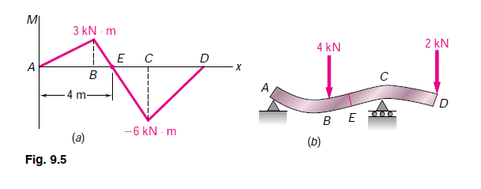

Slide 12
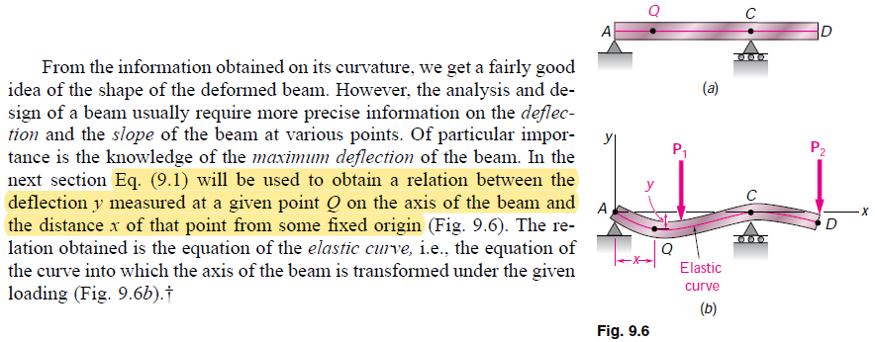

Slide 13
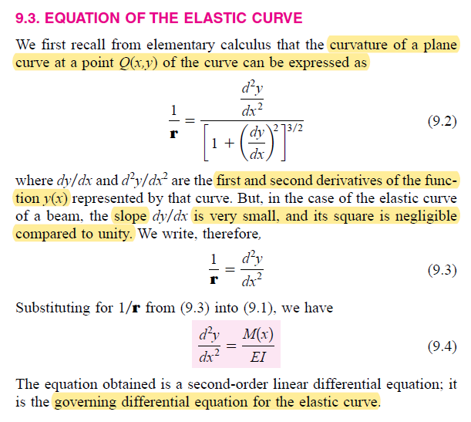

Slide 14
It should be noted that, in this chapter, y represents a vertical displacement, while it was used in previous chapters to represent the distance of a given point in a transverse section
from the neutral axis of that section.

Slide 15
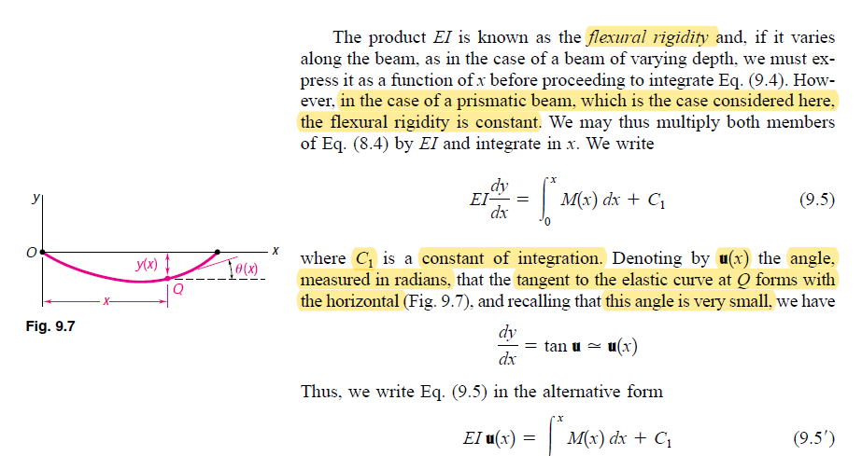

Slide 16
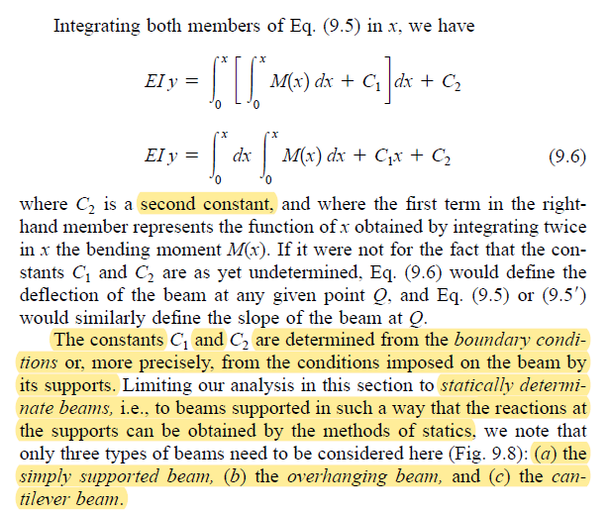

Slide 17
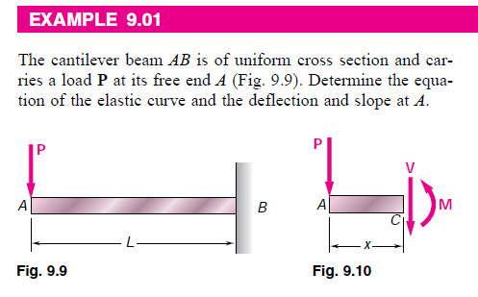

Slide 18
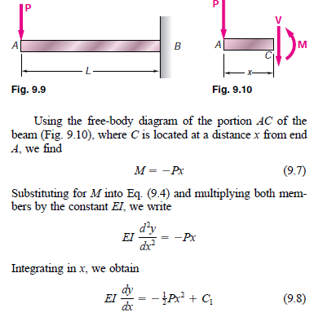

Slide 19
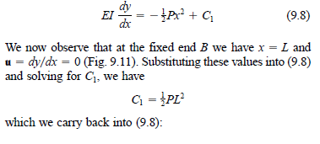

Slide 20
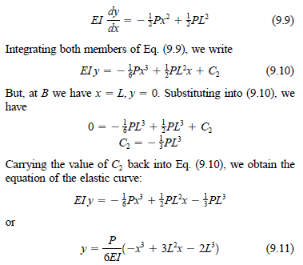

Slide 21
